Slide 1
Next Greek Yogurt Flavor
MSMA Team 8
Hector Abreu Hairong Wang Geng Luo Ying Wang Yunjiao Liu

Slide 2
Key Findings
Plain flavor has the largest market share of 17% in greek yogurt market.
Vanilla flavor has the largest market share of 13% in regular yogurt market.
Top 6 flavors, same as our existing product line, make up 64% of greek yogurt market share.
Blueberry ranks the top in greek yogurt flavor survey with 47% of customers willing to regularly buy it.
Since we sent the survey to our customers who already have loyalty card membership and purchase yogurt from us, we already reach 98% of the population using TURF.
44% of survey respondents regularly purchase raspberry (3rd).
39 % of survey respondents regularly purchase black cherry (4th).
Notes:
Our survey limited us because among the existing flavors, we already reached 98%of the population even when only considering Regular Buyers & Not Occasional buyers
Then, if not on reach, then on market acceptance and competitive landscape, we then think out 2 ways:
A: Try to influence switchers from regular yogurt (limit cannibalization)
B: Try to influence switchers / Interest from direct greek yogurt competitors

Slide 3
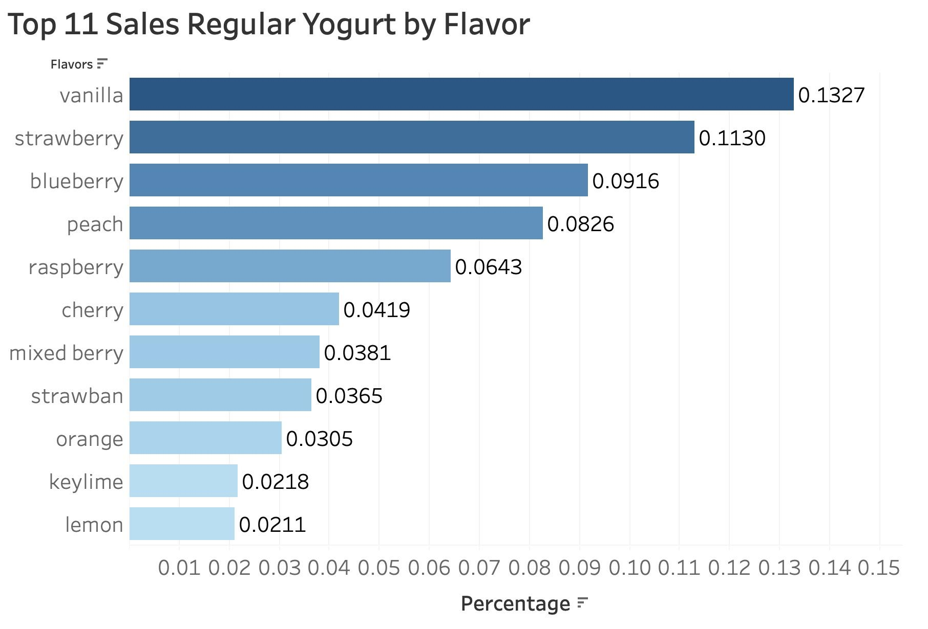
Raspberry, Encourage Regular Yogurt Consumers to Switch
Raspberry has highest sales in regular yogurt market excluding our existing flavors.
Compete within regular yogurt market, gain regular yogurt switchers.
Raspberry has market share within greek yogurt market (4%).
Notes:
Support for Recommendation 1: Raspberry
Help us compete within regular greek yogurt market, gain regular yogurt switchers
Because, it is the next largest flavor within non-greek yogurt & also has market share within greek yogurt market

Slide 4
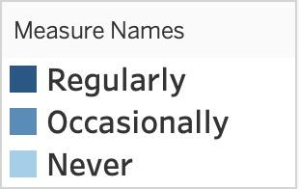
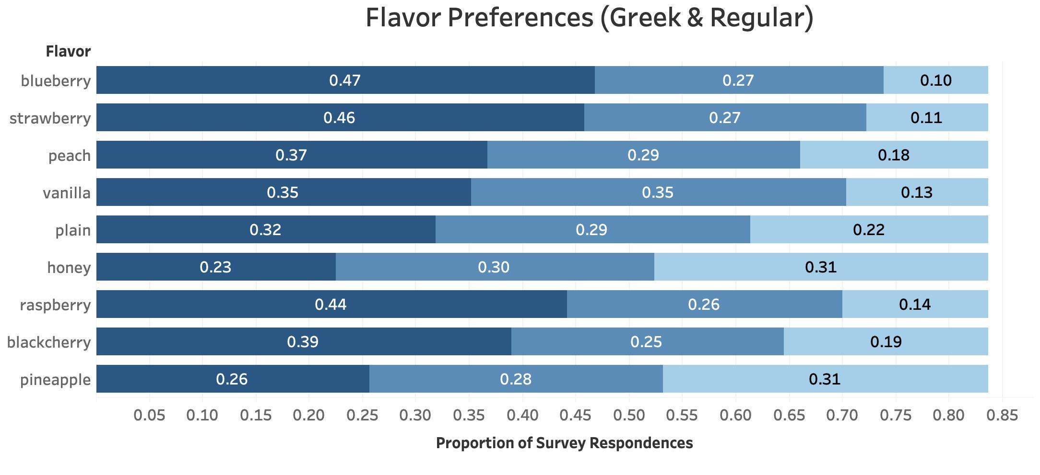


Excluding Existing Flavors, Raspberry Tops Regularly Purchased Flavors
Existing Product Line
Possible Set of Flavors to Launch
Notes:
B. Introduce already existed flavor, next most popular flavor outside of our existing set of flavors, Raspberry allows for new consumers
-Highly accepted by consumers in survey because of sampling plan
-Steal customers from adjacent product category

Slide 5
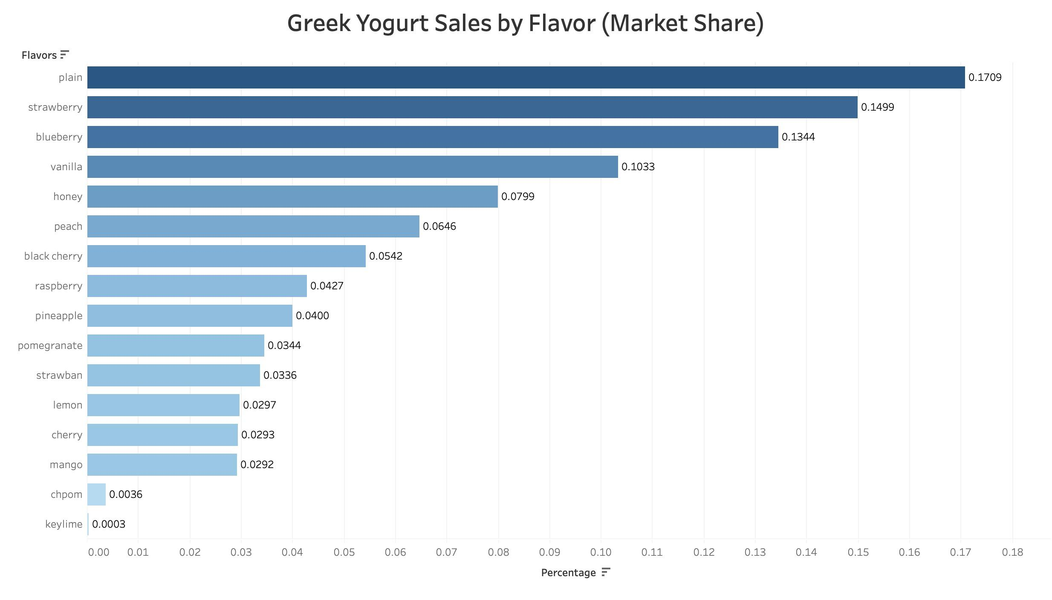
Greek Yogurt is our target market.
Top 6 flavors are existing private label Offerings.
Win over customers from direct greek competitors.
Black Cherry, Next Largest Market Share Amongst Greek Category
Notes:
Recommendation: Black Cherry
Outside of our existing set, most potential after raspberry
Compete directly with other Greek Yogurt Manufacturers
If you wanted to apply pressure within your market

Slide 6
After Raspberry, Black Cherry is Top Regularly Purchased Flavor
Existing Product Line
Possible Set of Flavors for Launch
Notes:
B. Introduce already existed flavor, next most popular flavor outside of our existing set of flavors, Raspberry allows for new consumers
-Highly accepted by consumers in survey because of sampling plan
-Steal customers from adjacent product category

Slide 7
Methodology Appendix
Decision-oriented project: Decide which flavor of Greek Yogurt to launch next in the product portfolio.
Measurement Goals:
1) Describe the percentage of sales of existing flavors in the Greek yogurt category (all brands)
2) Describe the percentage of sales of existing yogurt flavors outside of Greek yogurt (regular class of yogurt)
3) Describe survey respondents’ preferences for Greek yogurt flavors
4) Predict the best set of next flavors to add to achieve the highest reach using the survey data.
Data design: Historical sales data; Customer survey; Survey sample representative of population.
Data Limitations: Not able to meet representation requirement, doesn’t pass the chi-sq test in both perspectives of income and children.
Analytics task: find out which flavors are popular among customers, in both greek yogurt market and regular yogurt market. In greek yogurt market, we can introduce most popular potential flavor to gain more market share. From regular market, we can introduce most popular potential flavor for greek yogurt to win over more market share from adjacent product category.
Analytics tool: sales of each flavor to calculate market share of each flavor; preference of each flavor from survey; TURF model.
Visualization: bar chart showing sales of each yogurt flavor; stacked bar chart showing flavor preference(responding 0, 1, 2, which means regularly, occasionally and never respectively) .

